Slide 1
Basic Non-fungible tokens
Phillip G. Bradford

Slide 2
Agenda
Token model
Examples
Definitions

Slide 3

Definitions
Smart contracts

Slide 4
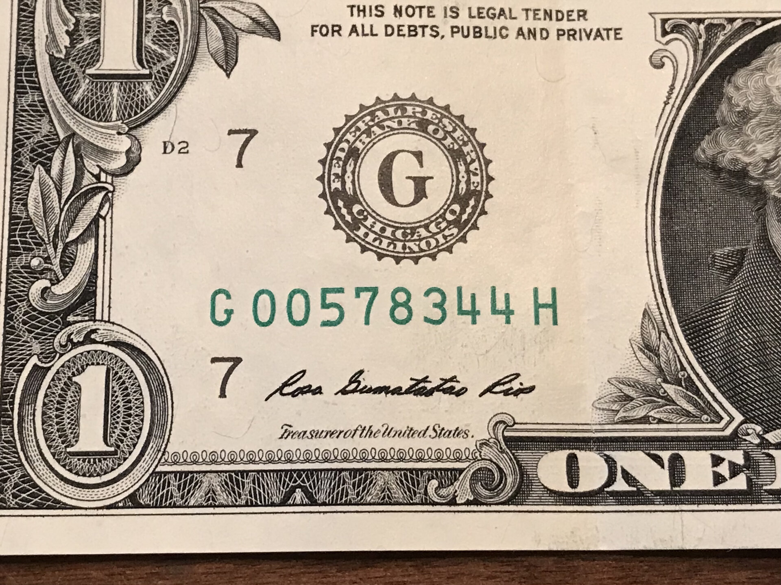
Fungibility

Slide 5
Non-fungible
Art
Land
Collectables
Notes:
https://docs.stacks.co/docs/clarity

Slide 6
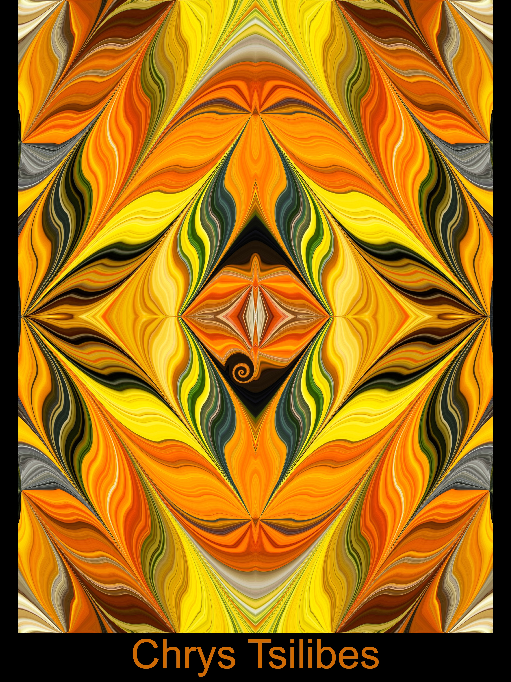
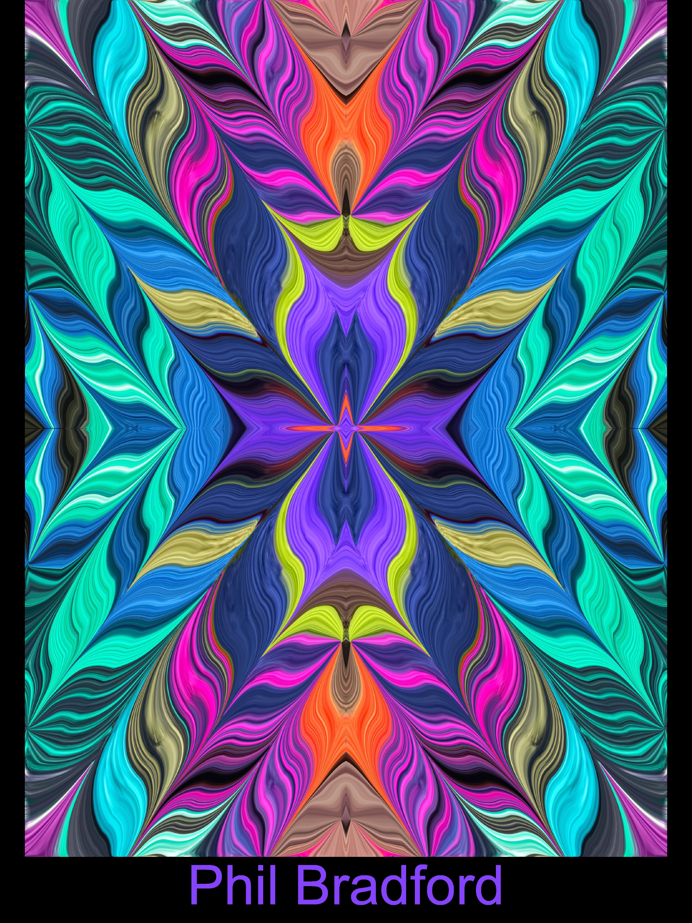
Examples

Slide 7
Central place for tokens
Distributed and validated
https://www.stacks.co/explore/nfts
https://www.stacks.co/explore/nfts#browsenfts

Slide 8

NFT Token model
Programming approaches

Slide 9
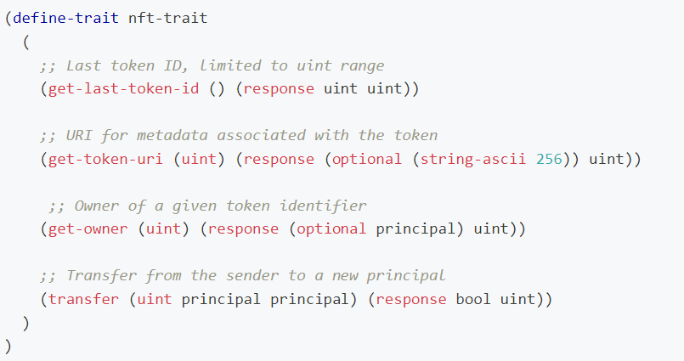
NFT Trait

Slide 10
Traits
Computer> cd proj024
Computer> clarinet requirements add SP2PABAF9FTAJYNFZH93XENAJ8FVY99RRM50D2JG9.nft-trait

Slide 11
Methods
https://docs.hiro.so/tutorials/clarity-nft

Slide 12
Example
Clarity of Mind Contract

Slide 13
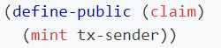
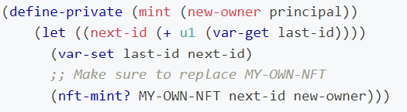
Stx transfers
https://docs.hiro.so/tutorials/clarity-nft

Slide 14
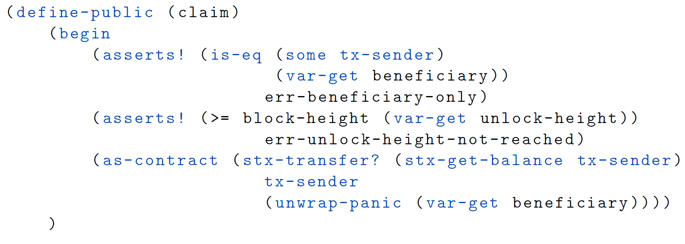
Claim

